Slide 1
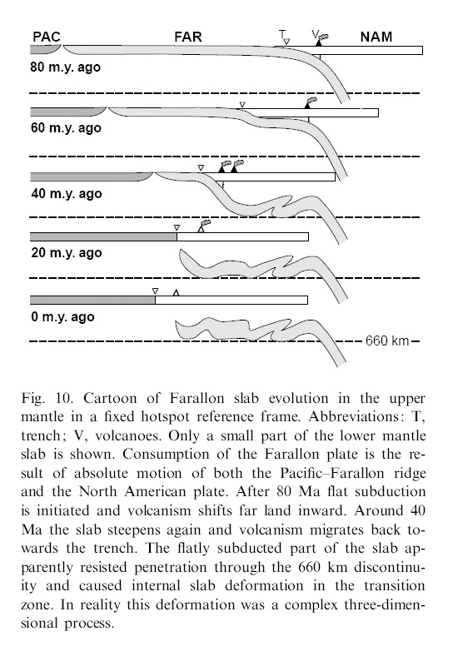
Laramide Orogeny
Notes:
The Laramide Orogeny did a lot more than fold limestone. When the subduction angle of the Farallon plate flattened, the volcanic arc shifted eastward.

Slide 2
Laramide Orogeny
Notes:
Notice the greater distance between the arc and trench during the Laramide Orogeny.

Slide 3
Laramide Orogeny
Mantle flow
Notes:
Following the Laramide Orogeny the convergence rate slowed between the Farallon Plate (FAR) and North American Plate (NAM), which gave time for the Farallon Plate to sink. Mantle flowed into the widening gap between the North American Plate and the sinking Farallon plate causing magmatism to shift back towards the trench. The result of all this on Big Bend is that arc magmatism shifted into the area during the climax of the Laramide Orogeny in the Eocene and Oligocene epochs, and then retreated from the area before Basin and Range extension began in the Miocene. As we learned from our study of the Basin and Range, extension of the continent causes bimodal volcanism, which in this case will be deposited on top of the Laramide age arc-related volcanic rocks.

Slide 4
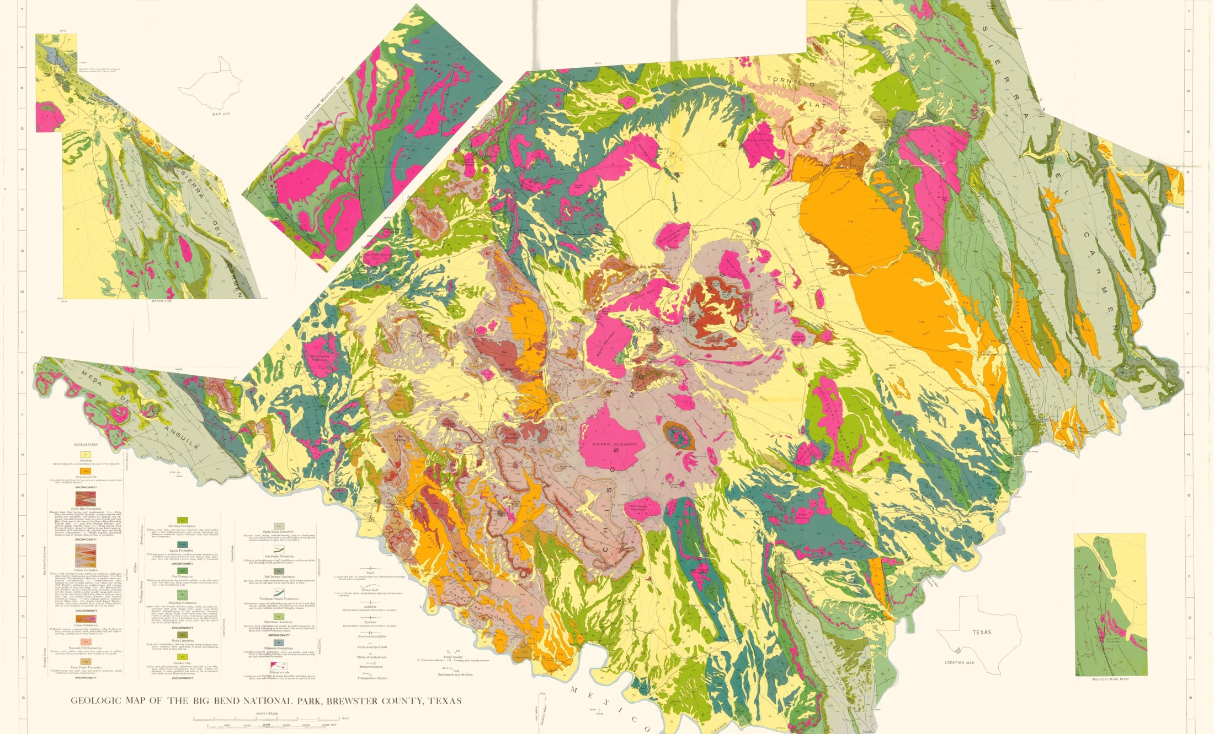
Laramide-age volcanic rocks
Notes:
In Big Bend National Park the Laramide-age volcanic rocks outcrop mostly in the central to southwestern portions of the park.

Slide 5
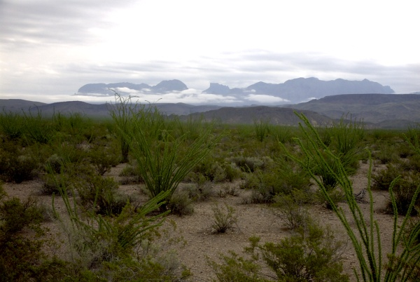
Chisos Mountains
Notes:
They are particularly noteworthy in the rugged Chisos Mountains – a nearly 8000-foot high jumble of volcanic rocks and shallow igneous intrusions.

Slide 6
Notes:
The Chisos Mountains are the eroded remains of two great volcanoes that once towered above the landscape, but like many great volcanoes, these collapsed into their magma chambers to form calderas.

Slide 7
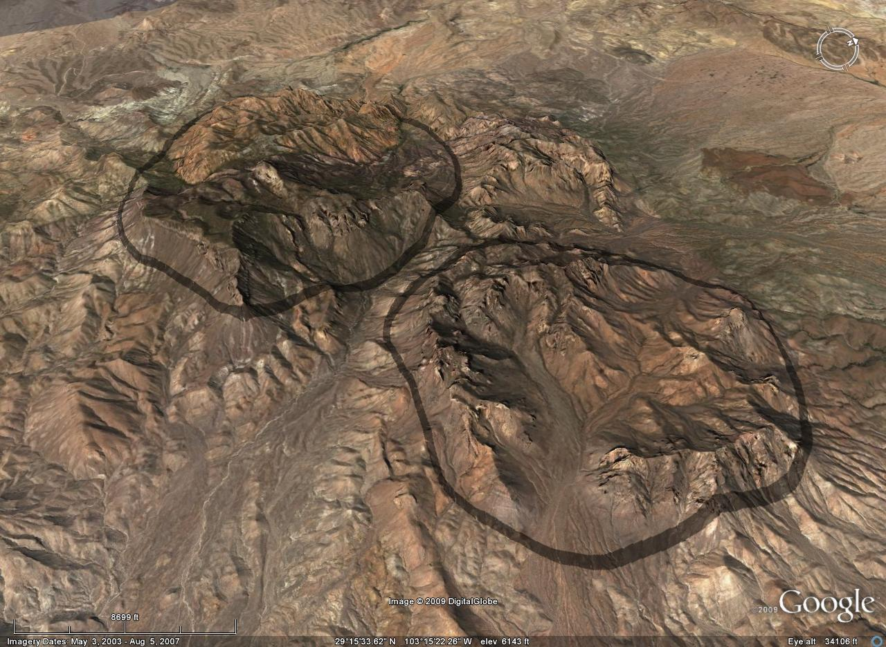
Notes:
The calderas are visible today, not as depressions, but as elevated, crudely circular areas because resurgent volcanism filled the two calderas with volcanic domes, lava, ash and surge deposits.

Slide 8
Ring dikes
Notes:
The structure is further complicated by the intrusion of dikes along the ring fractures that surrounded the calderas.

Slide 9
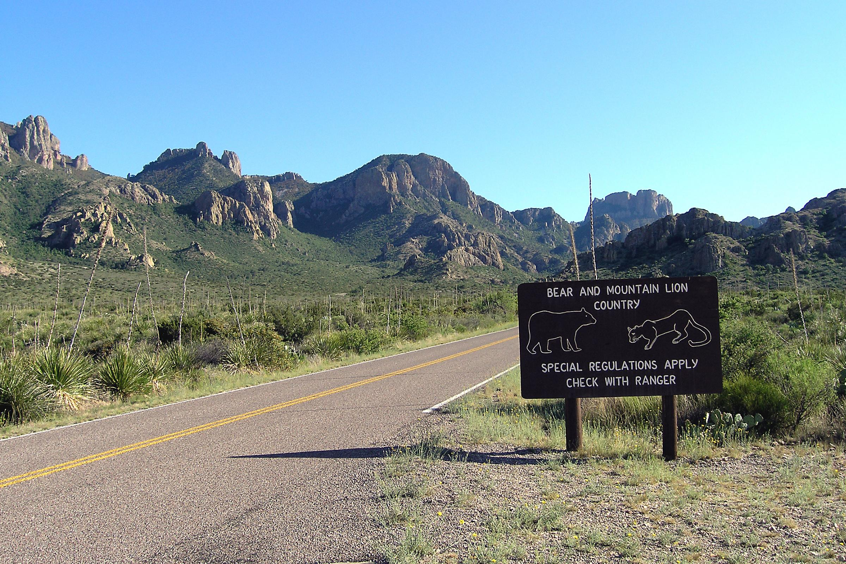
Notes:
The unusually chaotic topography of the Chisos Mountains mostly results from the intrusion of these ring dikes.

Slide 10
The Basin
Notes:
Towards the center of the more westerly caldera the softer ash layers have been eroded leaving a depression in the Chisos Mountains simply know as “The Basin”.

Slide 11
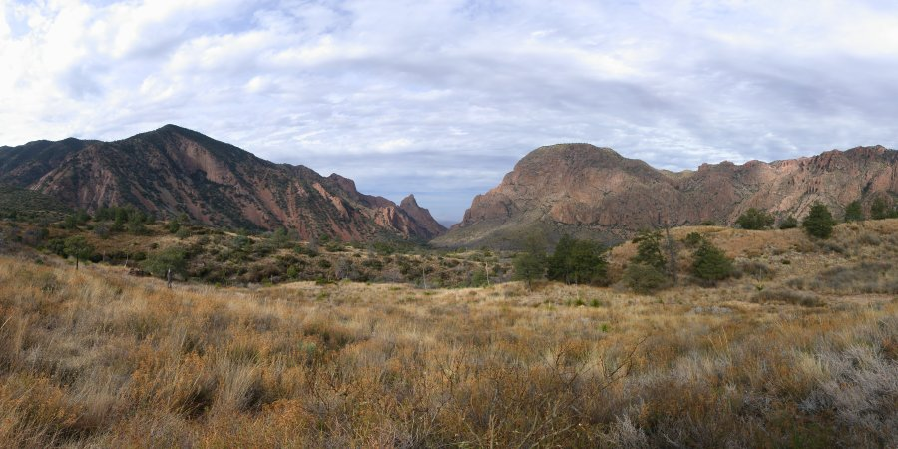
The Basin
Notes:
At almost exactly 1 mile high, The Basin provides welcome relief from the often oppressive west Texas heat. The surrounding intrusions and lava flows that make up the encircling mountains create a picturesque near-360 degree panorama that is the park’s most visited attraction.

Slide 12
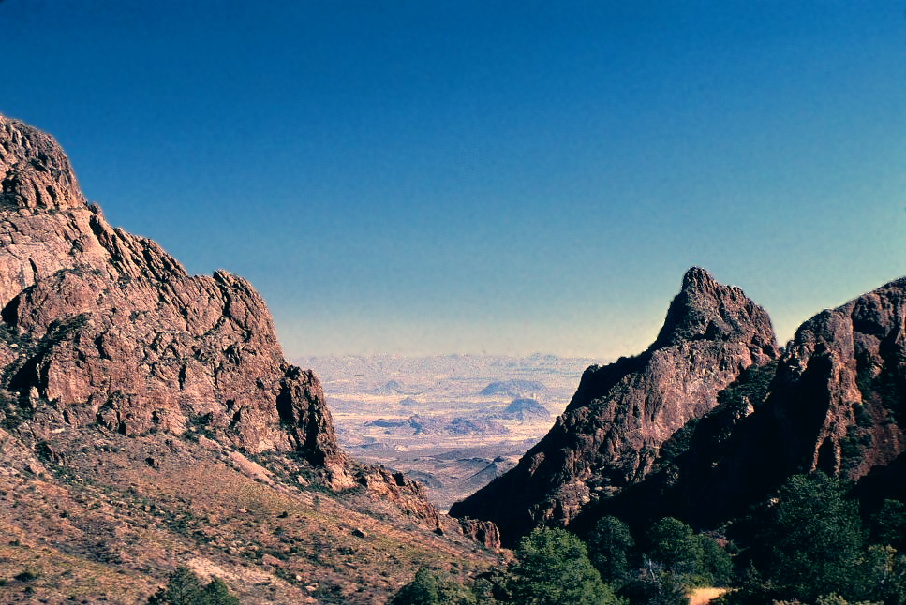
The Window
Notes:
Every drop of rain that falls on The Basin drains through one canyon, known as The Window because of the spectacular frame it provides to the distant lowland vista.

Slide 13
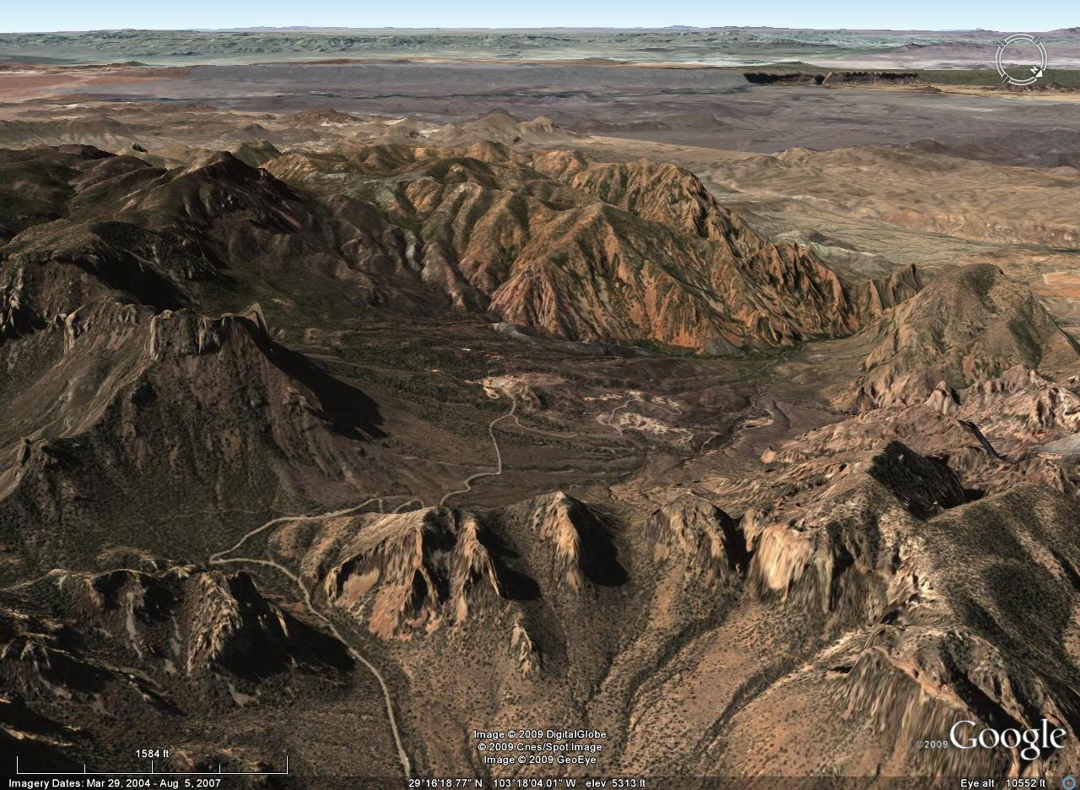
The Basin
Notes:
Most visitors to The Basin assume incorrectly that it had to form via some catastrophic event like the explosion or collapse of a volcano.

Slide 14
Ward Mountain
Notes:
Actually, the feature is only indirectly associated with the caldera here, and is more closely related to the erosion of the lava and ash that covered the caldera and the emplacement of the magmatic intrusion that comprises Ward Mountain. This intrusion pushed the lava-capped ash upwards into a broad dome. The fractured rocks forming the crest of the dome were eroded more rapidly than the lower rocks. Eventually, part of the lava cover was removed, exposing the underlying rocks. Erosion continued, breaching the lava until the underlying softer rocks in the center of the Basin were exposed.

Slide 15
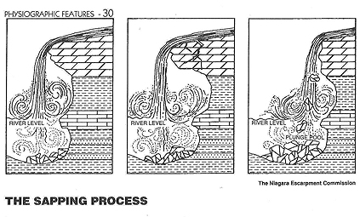
lava
ash and sandstone
Notes:
Sapping was an important process in forming the Basin. The softer volcanic ash and sandstone beds underlying the massive jointed lava cap were more easily eroded than the lava. The lava was undermined and fell into the valley below, and as the sapping continued, the lava cliffs retreated.

Slide 16
Casa Grande
Notes:
Casa Grande is a remnant of the all-but-eroded capping lava flow.

Slide 17
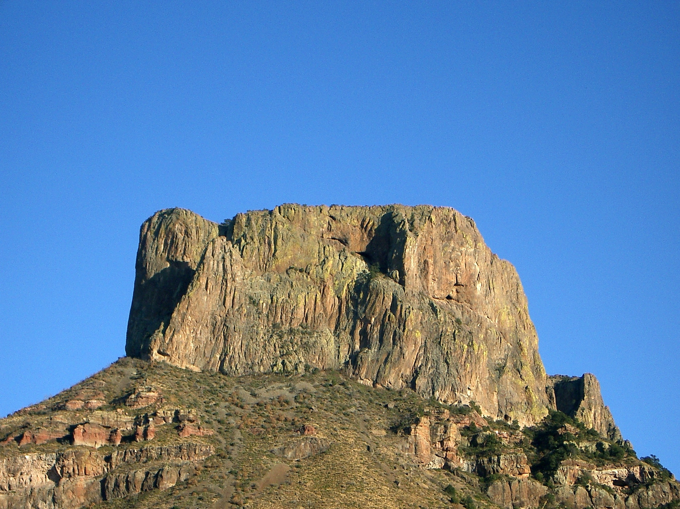
Casa Grande
Notes:
Towering above The Basin, it is one of the most obvious and photographed landforms in the park. Beneath it lie the softer ash deposits.

Slide 18
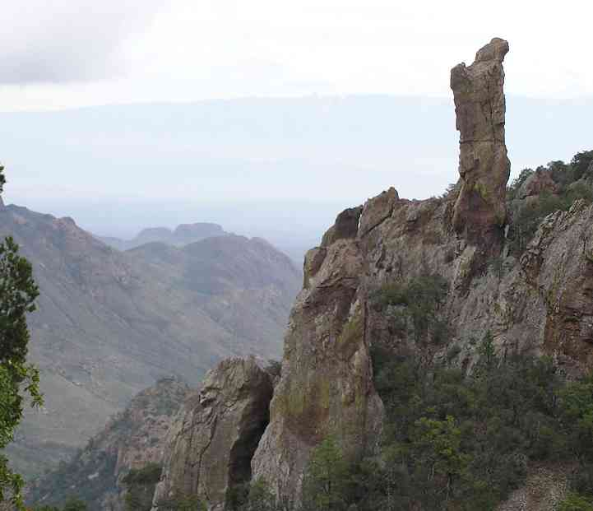
Notes:
Erosion along joints in the ash have resulted whimsical landforms like “Cowboy Boot”. These joints were formed by the forceful intrusion of magma below. Ash that has hardened into rock is known as tuff.

Slide 19
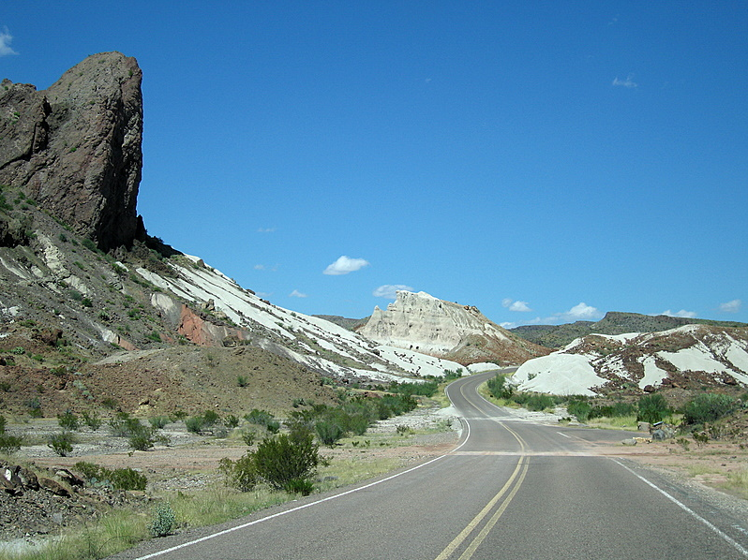
Notes:
Because volcanic ash can deposit far from its volcanic source, tuff blankets broad areas of Big Bend. It is particularly obvious towards the southwestern part of the park where it contrasts nicely next to the darker lava rocks capping it there.

Slide 20
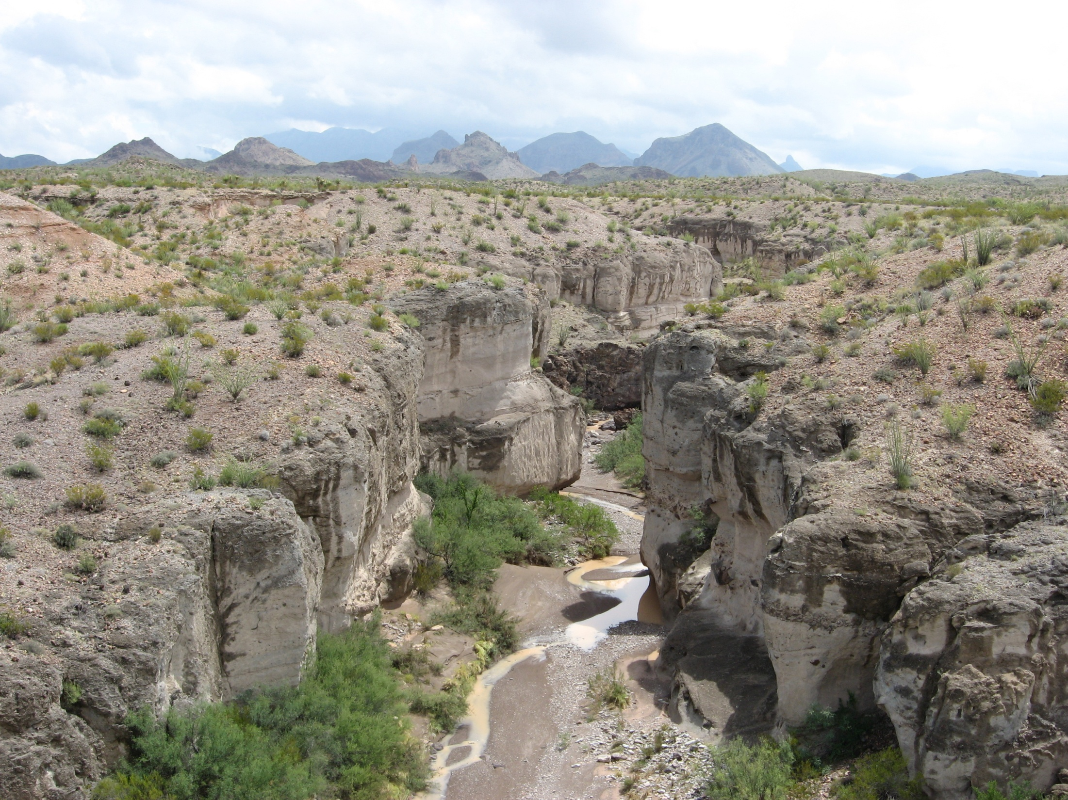
Tuff Canyon
Notes:
It is exposed beautifully along the walls of “Tuff Canyon”, more than 12 miles from the Chisos Mountains in the background.

Slide 21
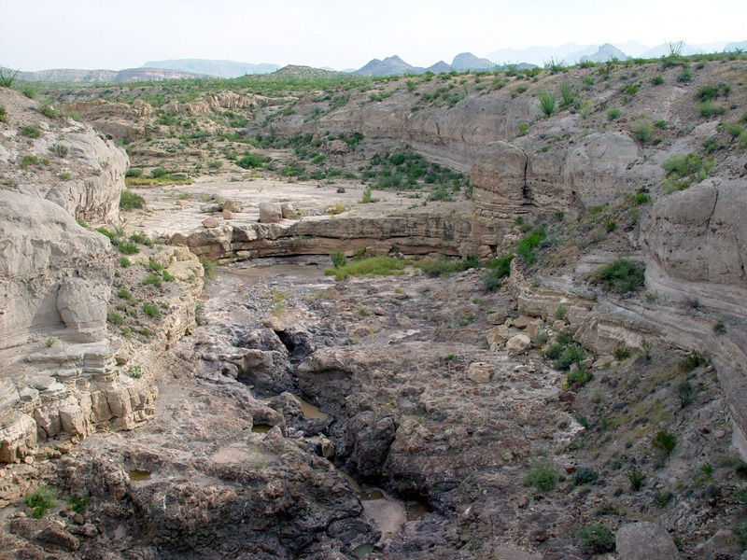
Notes:
You can see that even this “hardened” form of ash is not really very hard. It quickly erodes under the blade of running water.

Slide 22
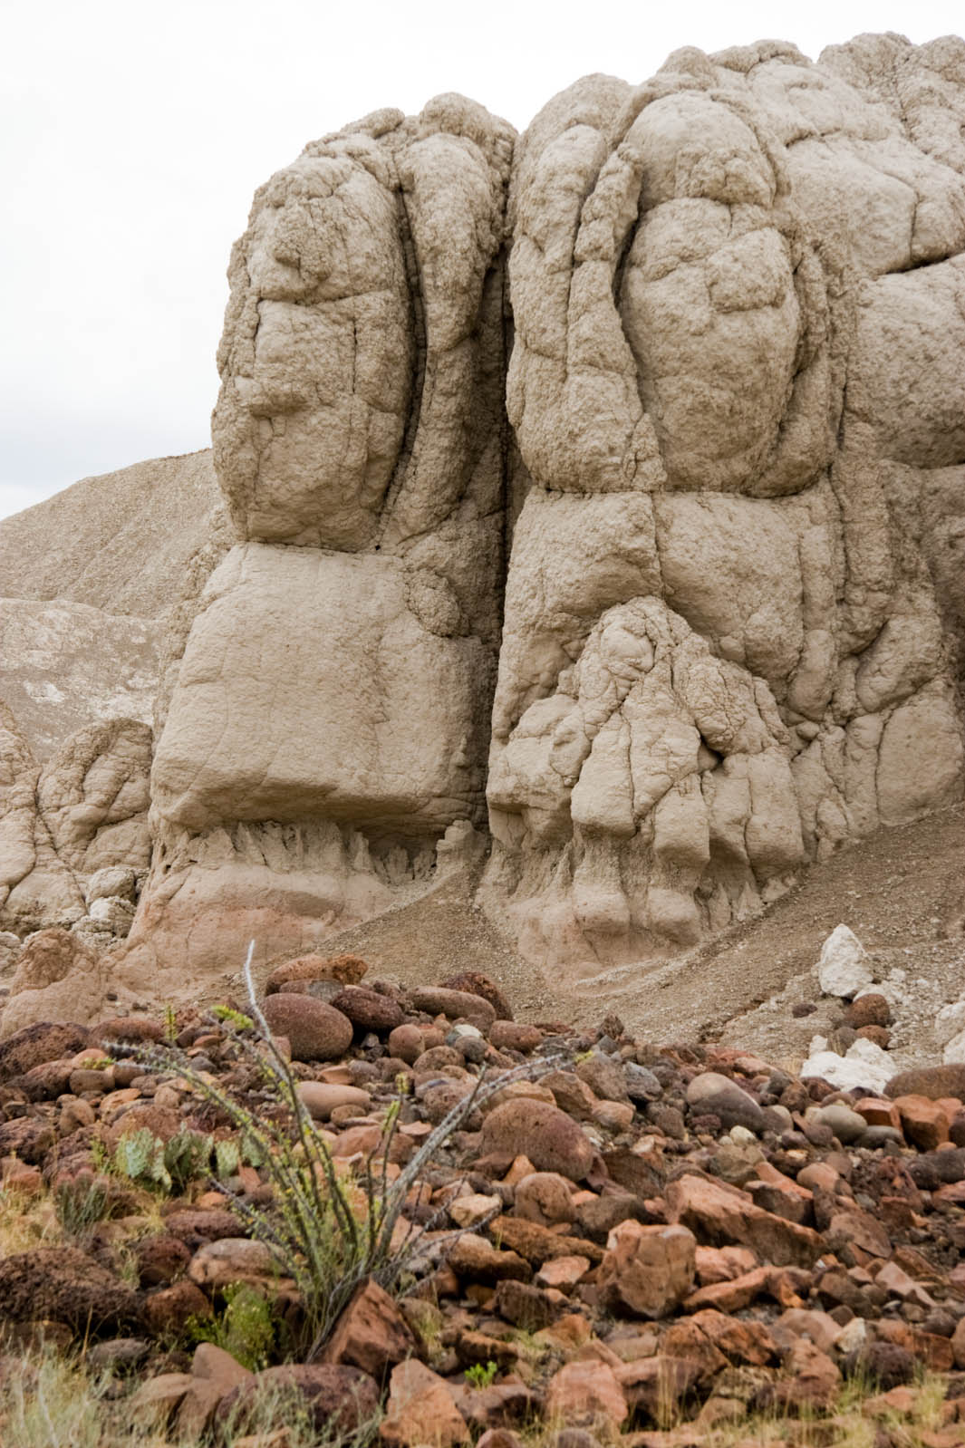
Notes:
Sometimes morphing into humanlike entities (even without the ingestion of a certain sacred cactus reported to grow in Big Bend!).

Slide 23
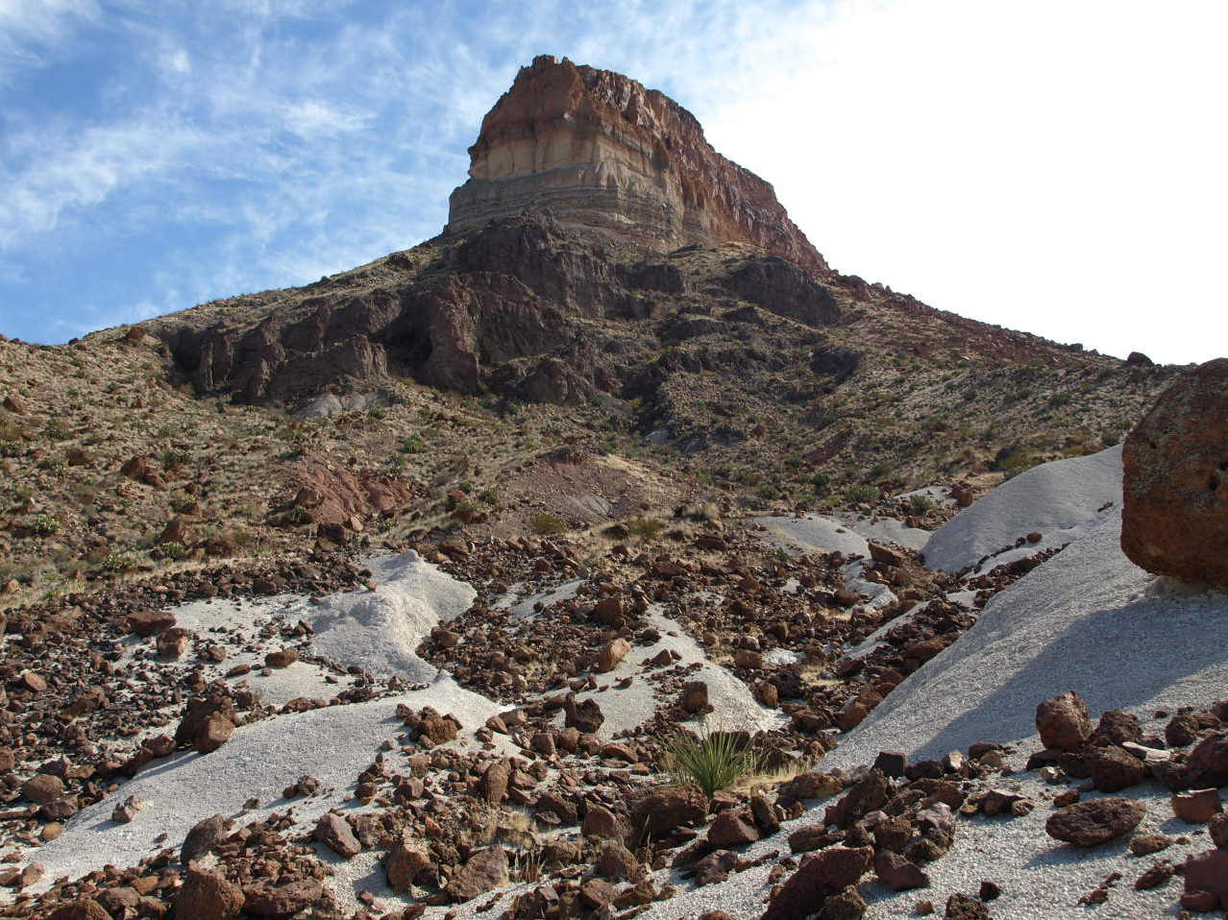
Cerro Castellan
Notes:
Just next door to Tuff Canyon is Cerro Castellan where the tuff is overlain by younger lava flows.

Slide 24
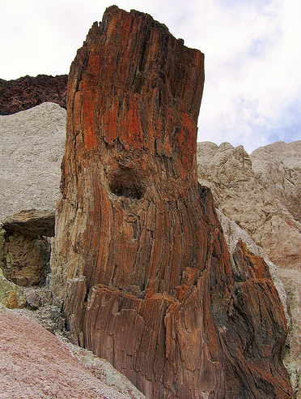
Notes:
At the base of Cerro Castellan there is a hardened “lava neck” through which magma once flowed toward the surface. The remarkably wood-like grain results from flow-induced shear-stress, which was unusually high due to the extreme viscosity of the silica-rich magma combined with the narrow diameter of the neck. The “knot-hole” probably once held a rock that was carried upward by the magma.

Slide 25
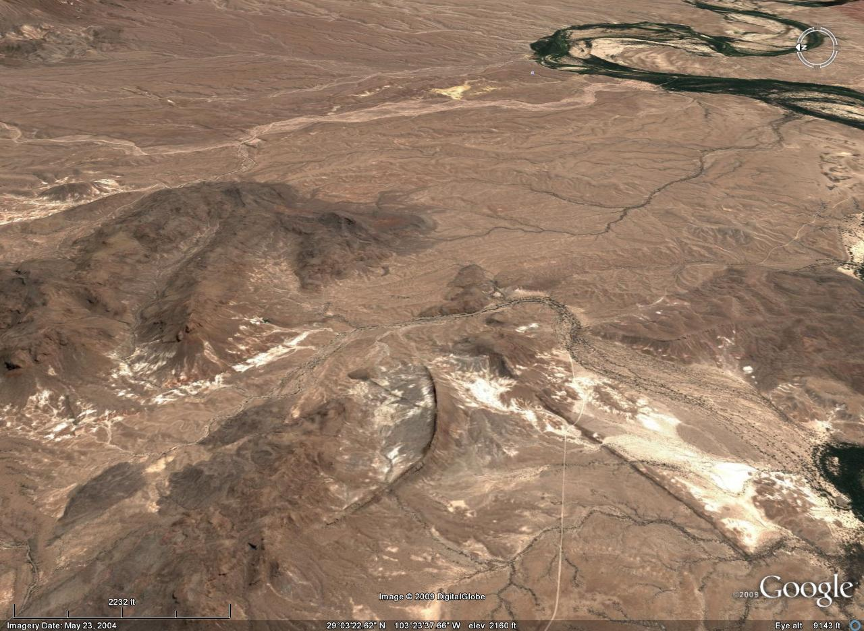
dike
dike
Notes:
Magma was more commonly brought to the surface via a system of feeder dikes. Some of these dikes are remarkably continuous relative to their thickness. This one is only about 20 feet thick, yet it can be traced across the surface for more than 12 miles!

Slide 26
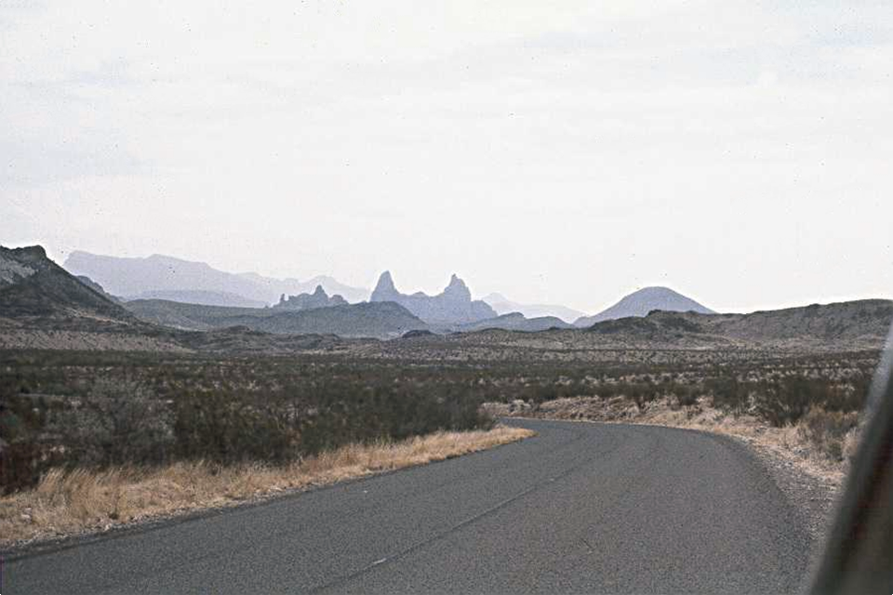
Mule ears
Notes:
Others, like the dike that was eroded into the “Mule Ears” …

Slide 27
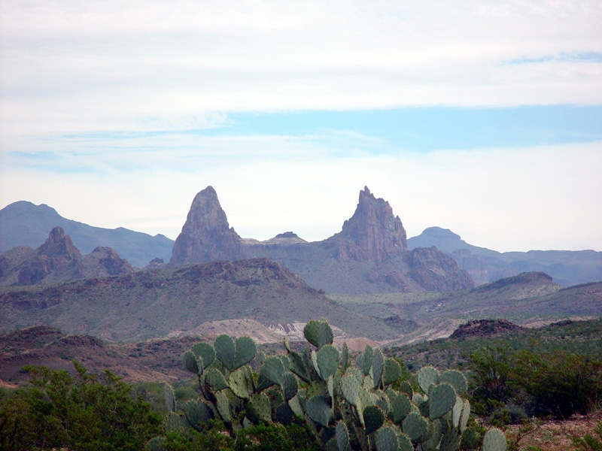
Notes:
… is several hundred feet thick yet much less laterally continuous.

Slide 28
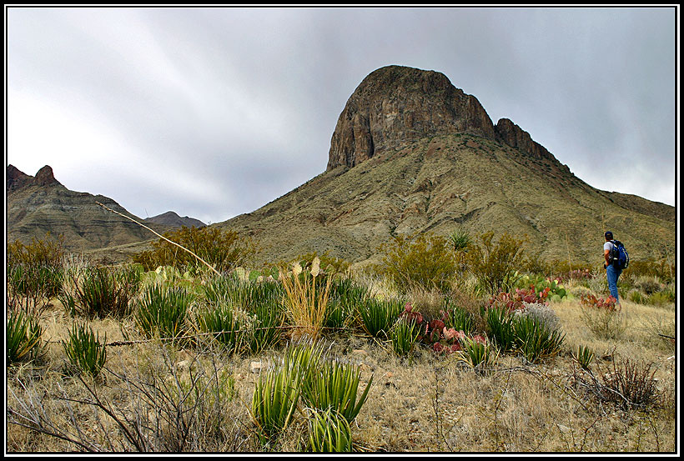
Elephant Tusk
Notes:
“Elephant Tusk” is yet another Big Bend igneous intrusion. Although almost every imaginable size and shape of igneous intrusion is here, the majority formed from felsic magma that crystallized fairly close to the surface.

Slide 29
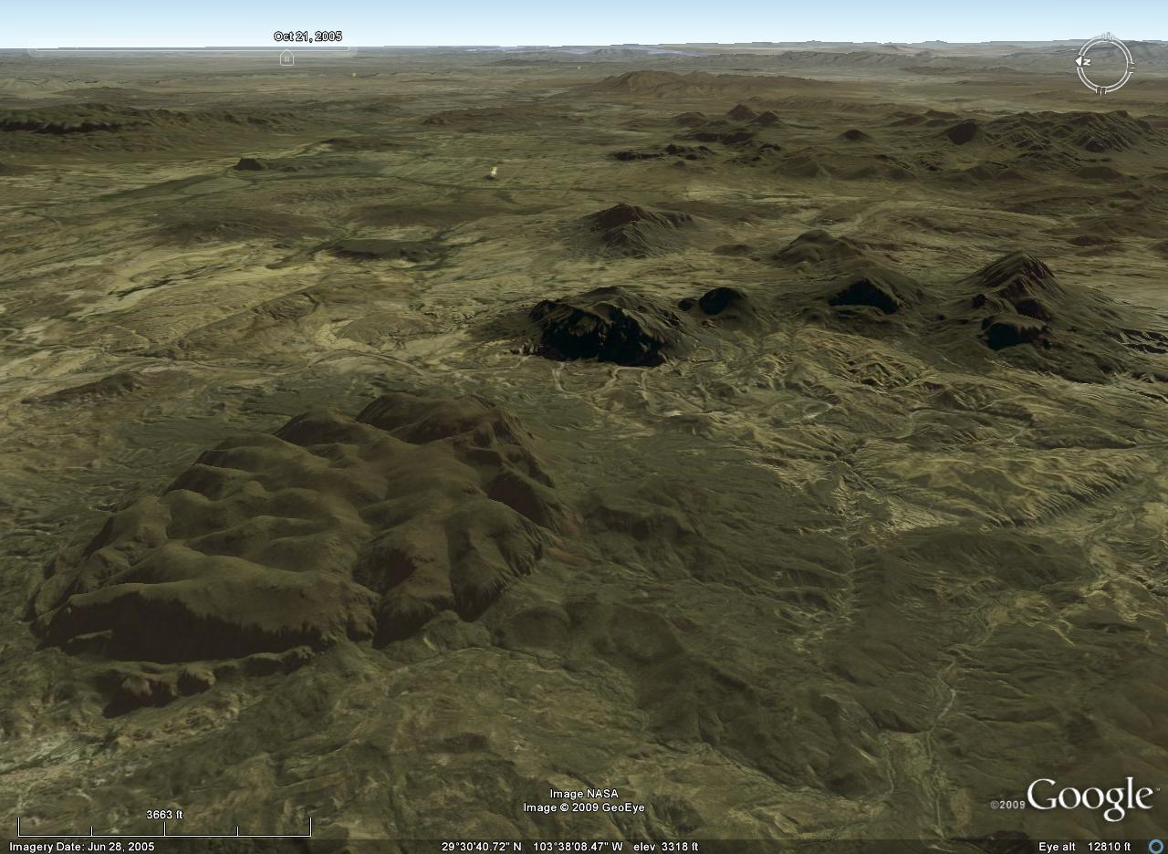
Laccoliths
Notes:
Of these, laccoliths are particularly common in Big Bend National Park, although they are relatively uncommon intrusions elsewhere.

Slide 30
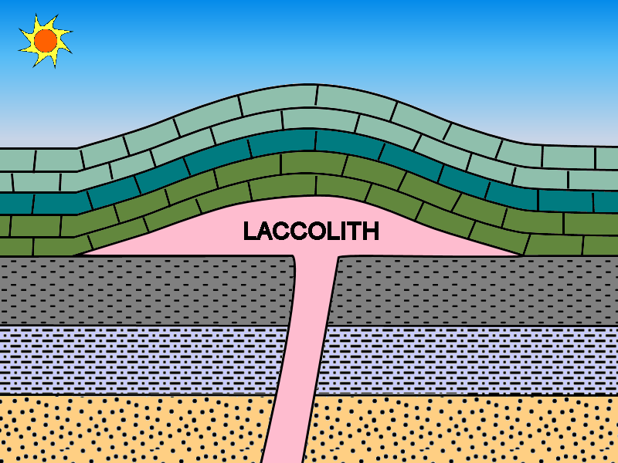
Notes:
To form the characteristic mushroom-shaped intrusions, viscous, felsic magma must be emplaced between rock layers at a depth shallow enough to allow for the doming of the rocks above the laccolith. Mafic magma can not form laccoliths because its lower viscosity makes it spread out more thinly between the layers (forming sills). The rise of laccolith-forming magma is driven by the relatively low density of felsic magma. Felsic magma is so buoyant in fact, that in most situations when it gets close enough to the surface to form a laccolith, it is less dense than the surrounding rocks so it just keeps rising to the surface. That’s why laccoliths are rare worldwide.

Slide 31
Less dense than laccolith
More dense than laccolith
Notes:
Laccoliths are common in Big Bend, however, because the surface rocks here are limestones and tuffs whose density is low enough to float atop the magma that formed the laccolith. The pairing of limestone and felsic magma is geologically unusual and reflects the great distance to which Laramide magmatism swept into the interior of North America – all the way into an environment rarely affected by arc magmatism, the limestone-filled forearc basin.

Slide 32
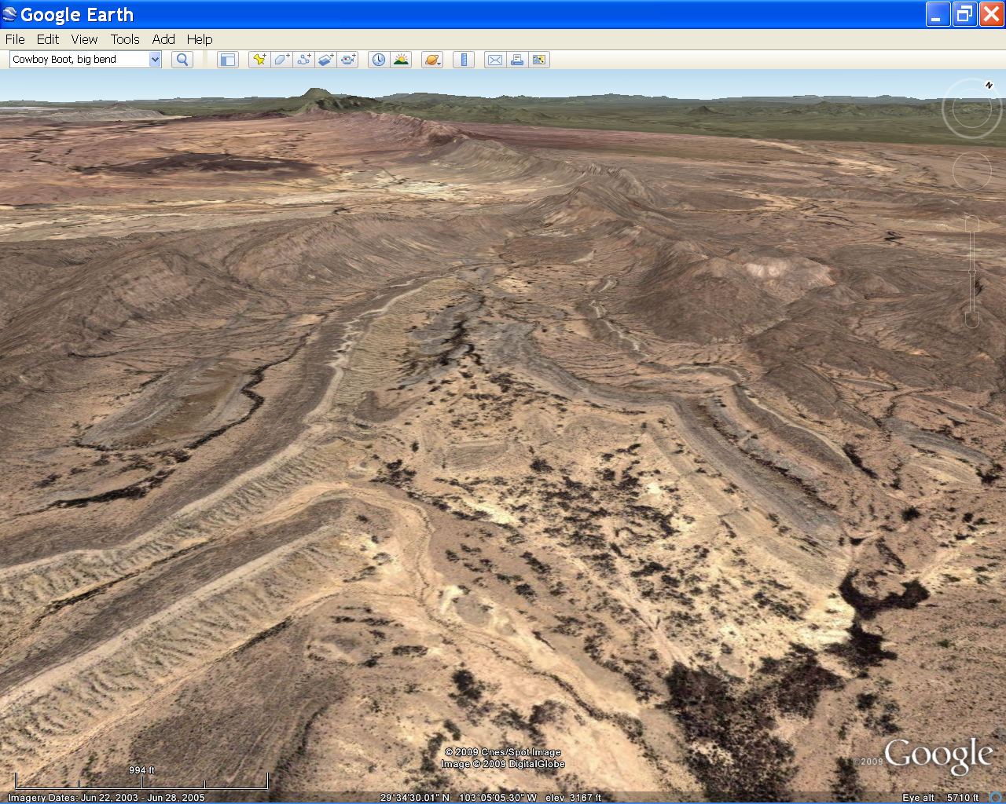
Big Bend Geologic History
Late Paleozoic: Ouachita folds and thrusts
Early Mesozoic: Peneplanation
Late Mesozoic: Foreland basin sedimentation
Early Cenozoic: Laramide folding and magmatism
Late Cenozoic: Erosion, deposition and Basin & Range extension
Notes:
Laramide folding and magmatism …

Slide 33
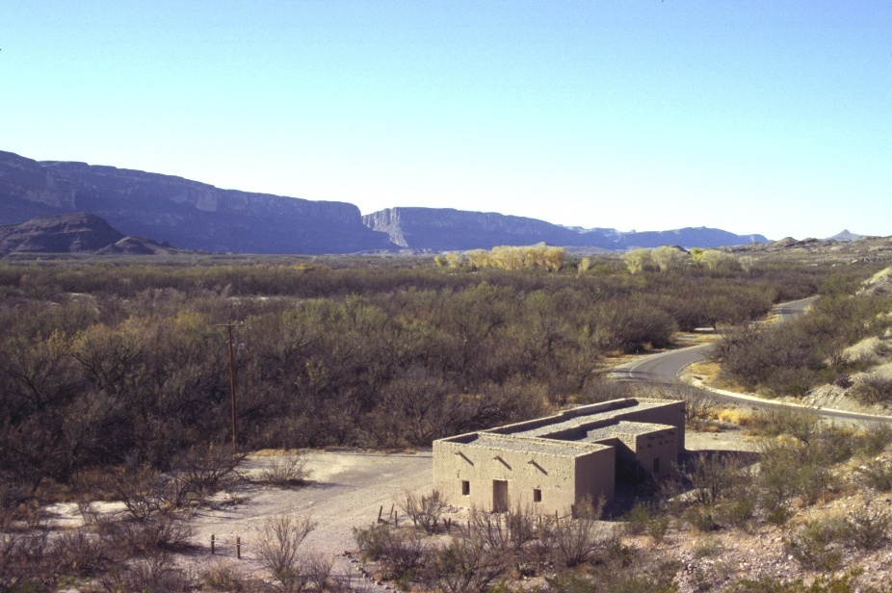
Big Bend Geologic History
Late Paleozoic: Ouachita folds and thrusts
Early Mesozoic: Peneplanation
Late Mesozoic: Foreland basin sedimentation
Early Cenozoic: Laramide folding and magmatism
Late Cenozoic: Erosion, deposition and Basin & Range extension
Notes:
… gave way to Basin and Range extension in the late Cenozoic, which produced long, conspicuous, linear escarpments along major normal faults.

Slide 34
Santa Elena Canyon
Notes:
The scarp cut by Santa Elena Canyon is particularly noticeable.

Slide 35
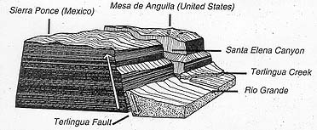
Notes:
At its base lies the Terlingua Fault above which a much thicker pile of sediments had accumulated, but now are mostly eroded.

Slide 36
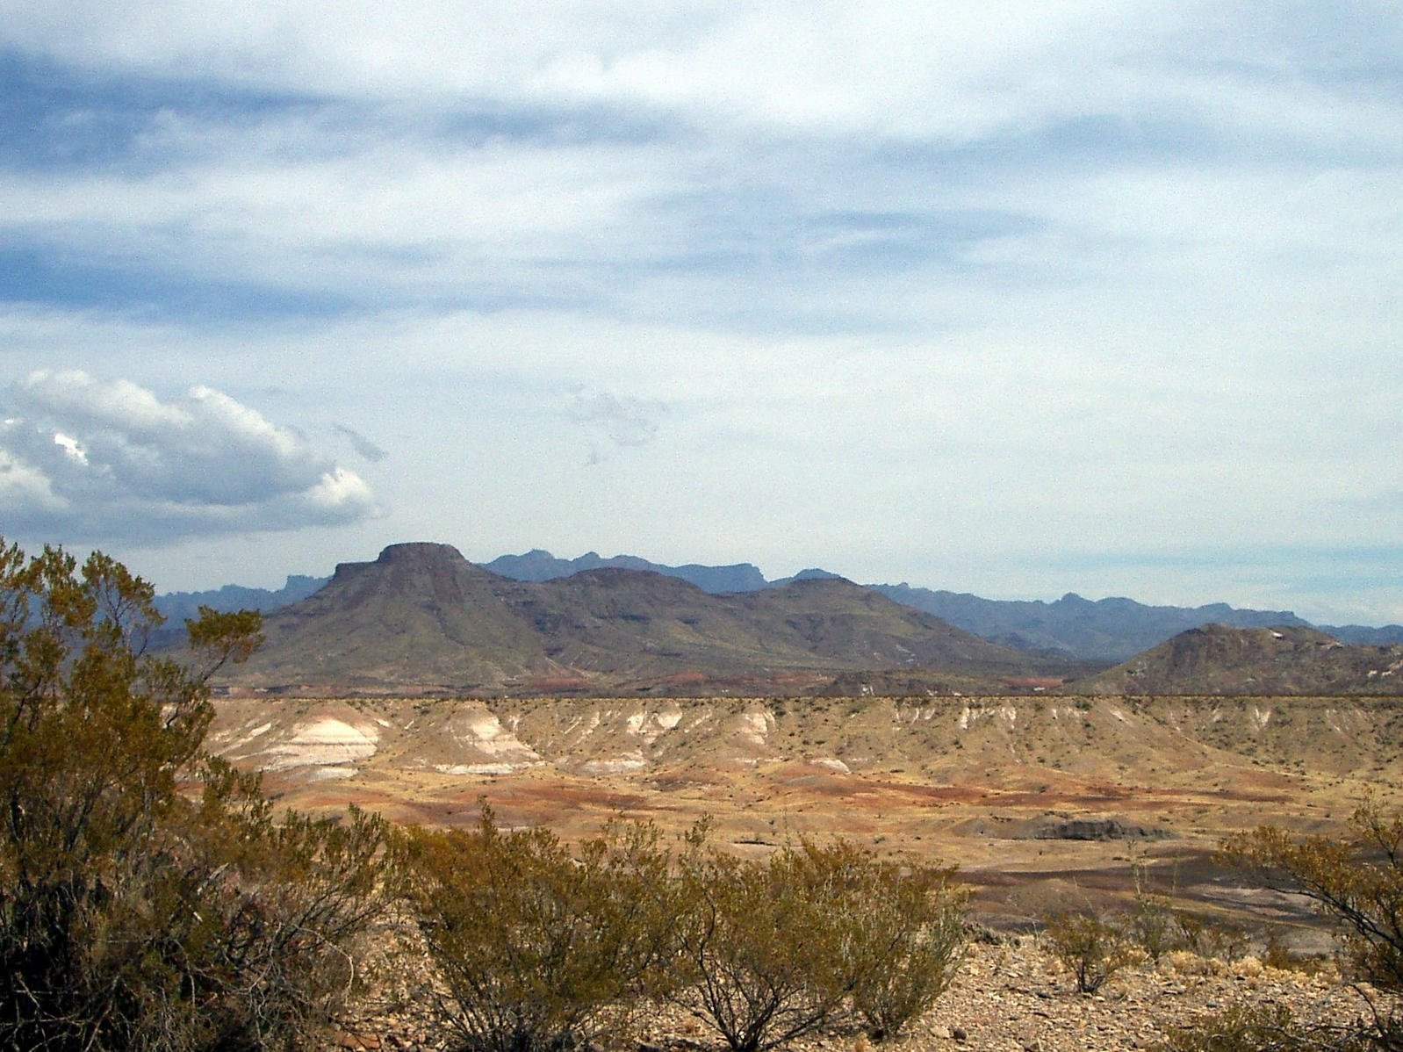
Big Bend Geologic History
Late Paleozoic: Ouachita folds and thrusts
Early Mesozoic: Peneplanation
Late Mesozoic: Foreland basin sedimentation
Early Cenozoic: Laramide folding and magmatism
Late Cenozoic: Erosion, deposition and Basin & Range extension
Notes:
Intense episodes of erosion and deposition accompanied the Basin and Range extension of the Big Bend area as climate and extension rates fluctuated.

Slide 37
Relict depositional / erosional surface
Notes:
Remnants of late Cenozoic depositional and erosional surfaces abound in Big Bend. Although not as geologically sexy as laccoliths and Laramide anticlines, they are nonetheless an important component …

Slide 38
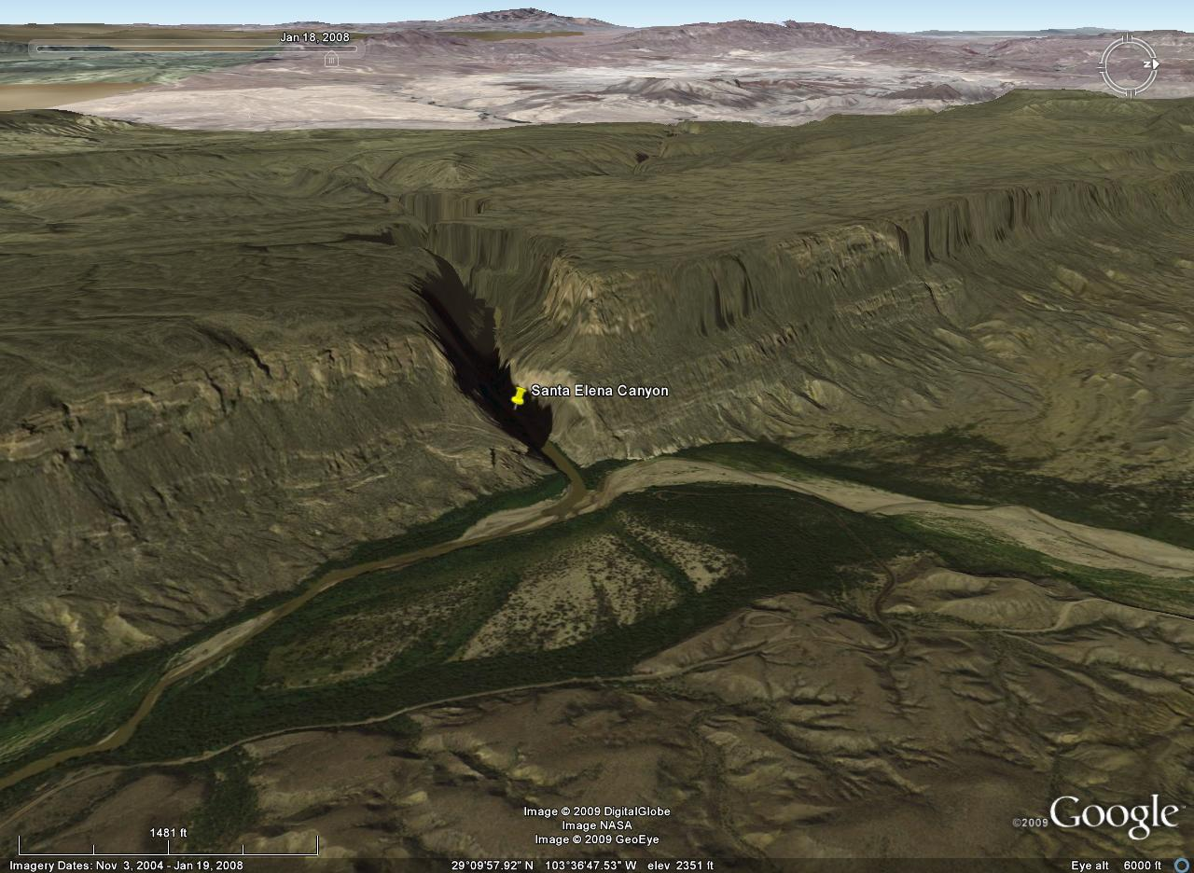
Notes:
… in the formation of the gorgeous slot canyons (like Santa Elena) that slice across the normal fault scarps. The Rio Grande River here is a transverse stream – meaning that it flows across the faults and fault blocks. It is also superimposed, …

Slide 39
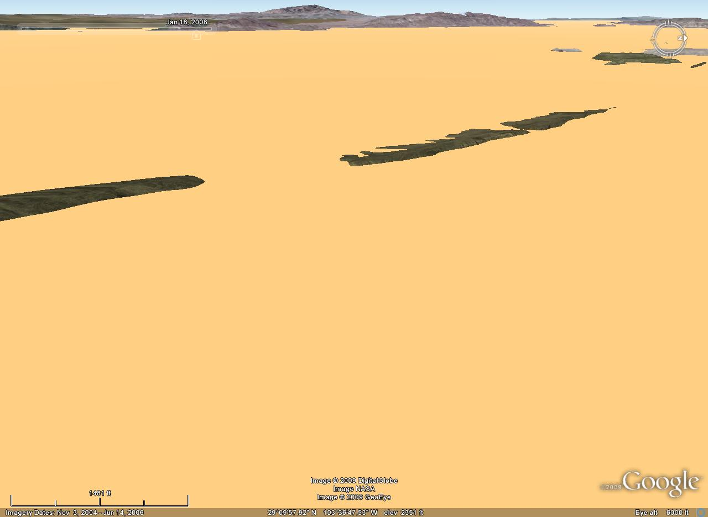
Notes:
… which means that it was let down from higher levels …

Slide 40
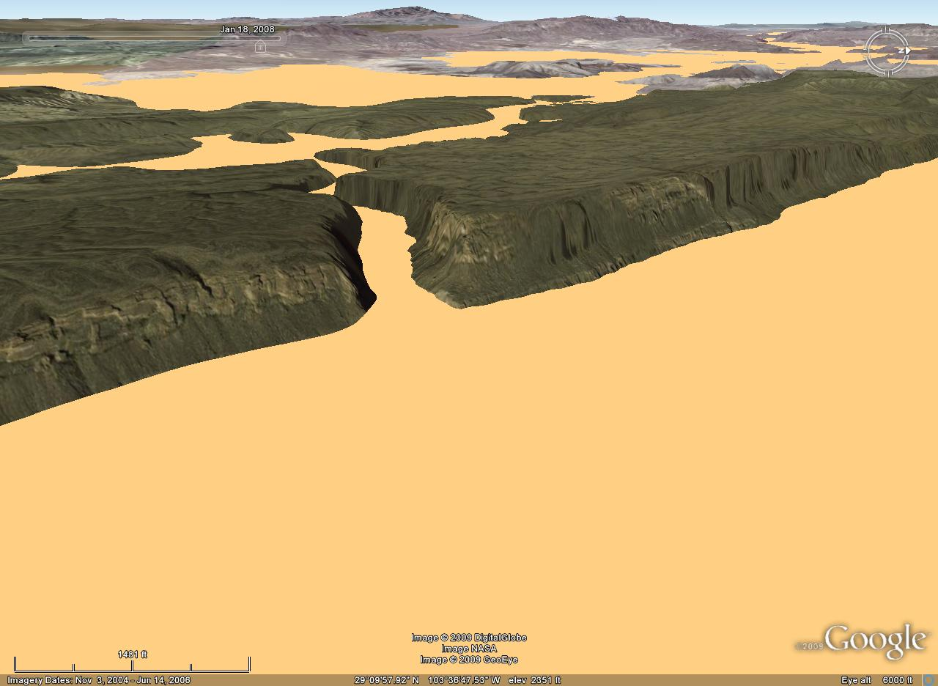
Notes:
… by erosion. During downcutting, the Rio Grande and its tributaries removed sand and gravel that once filled the basins …

Slide 41
Notes:
… and exposed the bedrock of the upfaulted blocks.

Slide 42
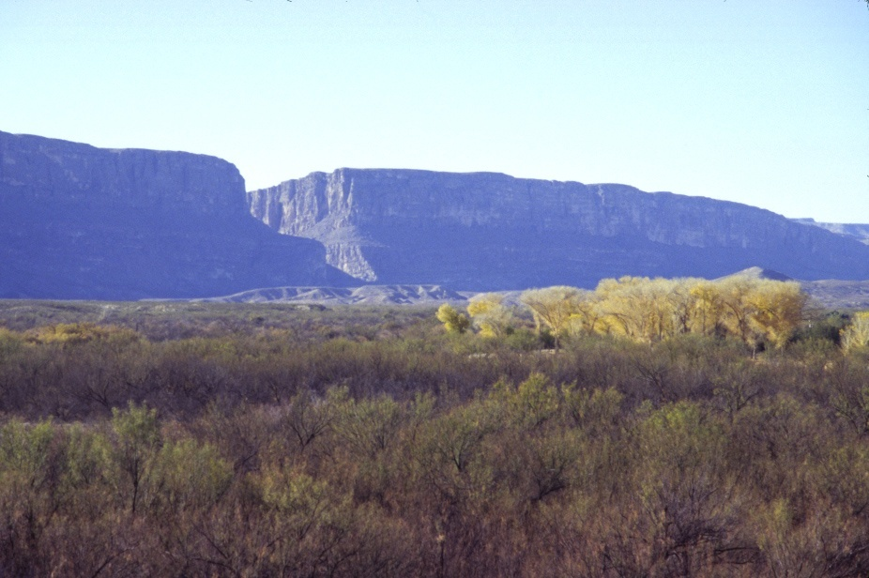
Notes:
So the basin in the foreground was once filled to its brim with sediment. Santa Elena Canyon will become even deeper as sediment continues to be removed from the basin. One might ask why this process happens along the Rio Grande but not in other parts of the Basin and Range.

Slide 43
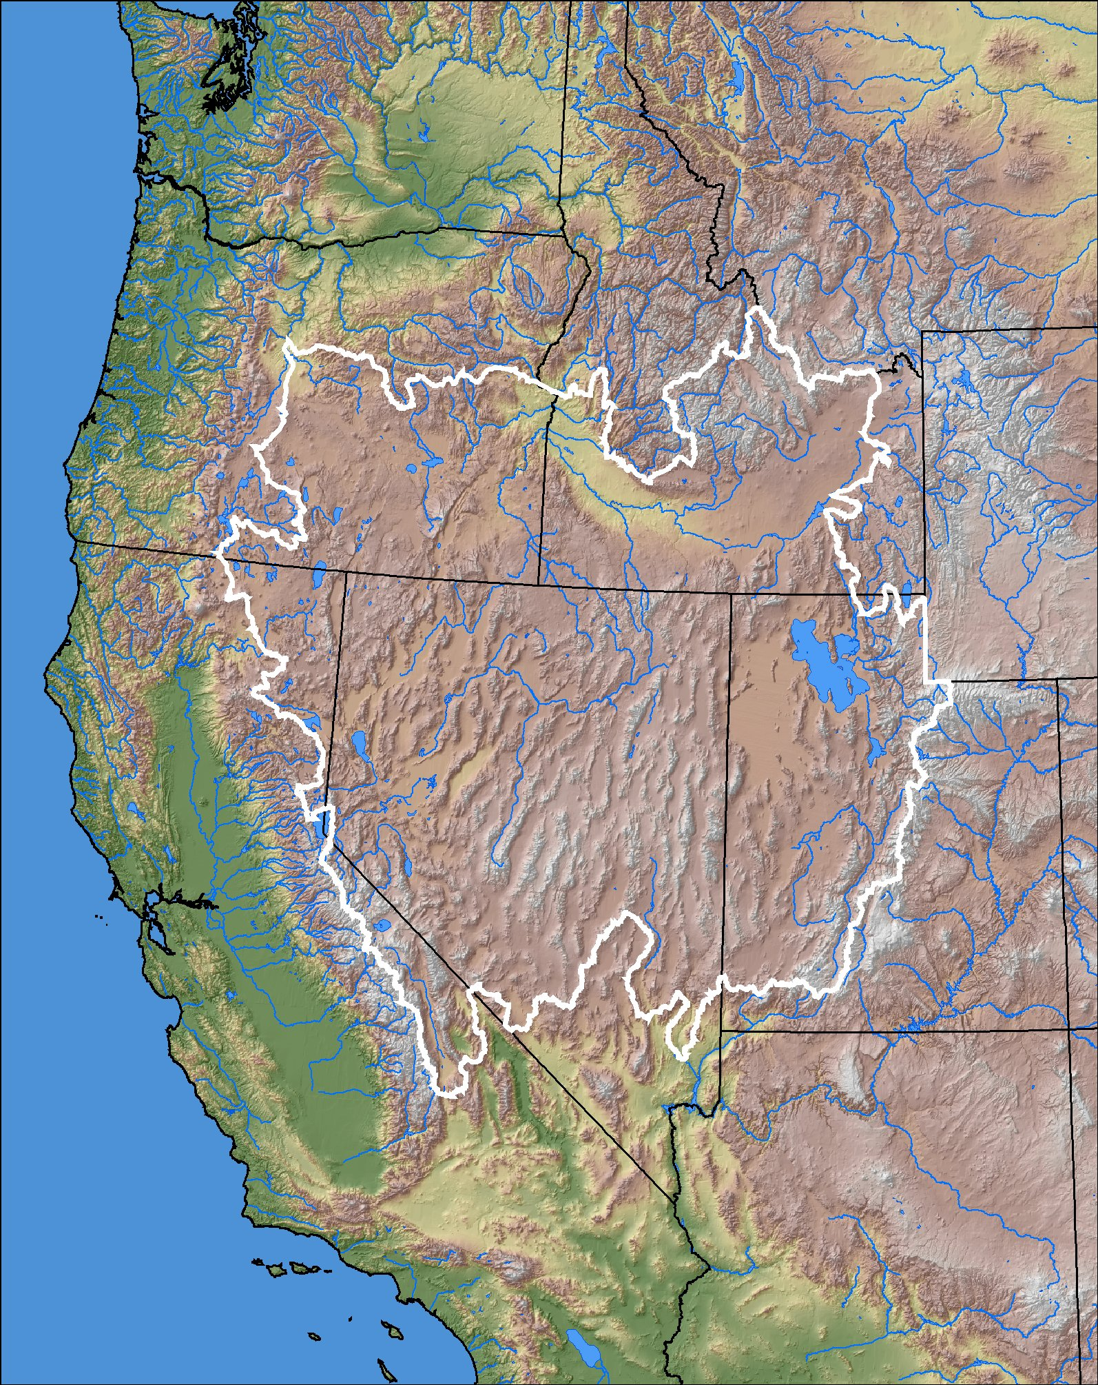
Great Basin
Notes:
Remember that there is no outlet for rivers draining into the Great Basin, so sediment ultimately accumulates there.

Slide 44
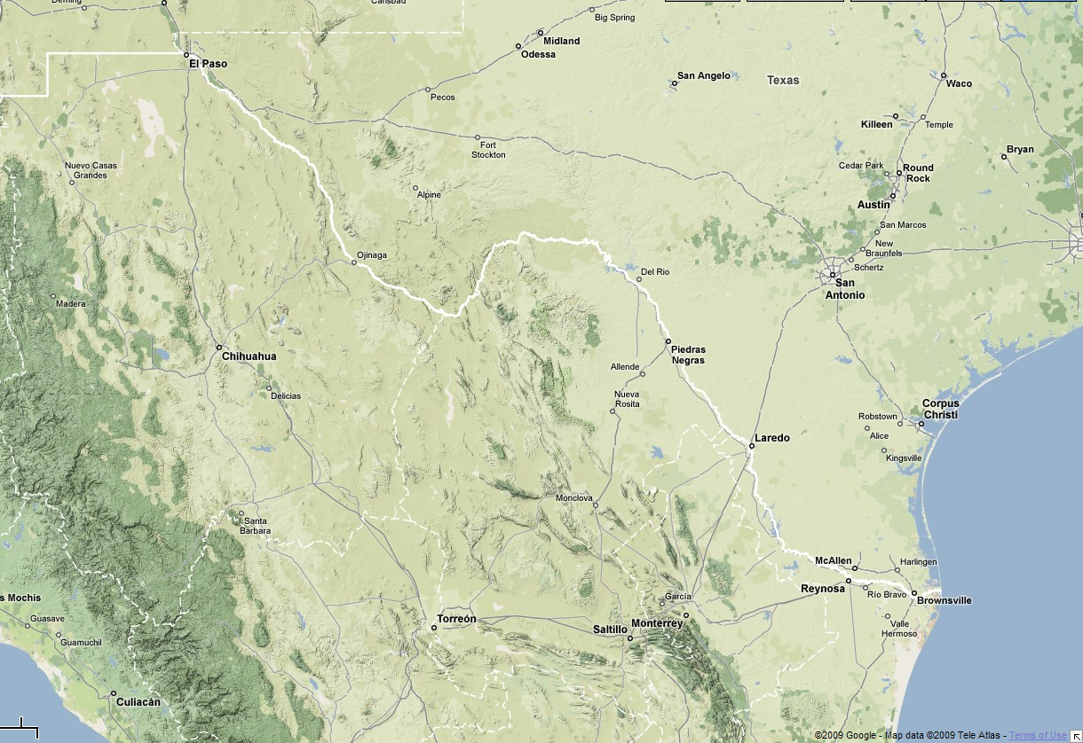
Notes:
Areas drained by the Rio Grande River, however, are ultimately eroded, because the Rio Grande exits into the Gulf of Mexico. Note the protruding coastline at Brownsville, where mass quantities of the eroded sediment have deposited.

Slide 45
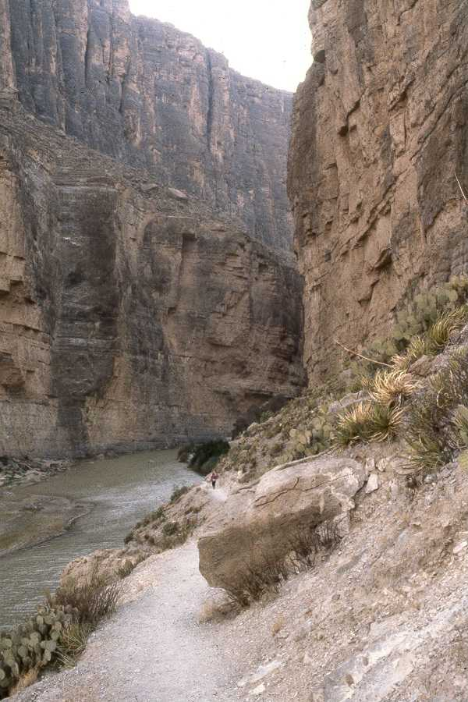
Notes:
The removal of basin sediment has caused the Rio Grande River to downcut so rapidly in Santa Elena Canyon that there has been little time for widening processes to occur.

Slide 46
USA
Mexico
Notes:
The result is that some places in Santa Elena Canyon are so narrow that you can touch the walls of Mexico and the United States with outstretched arms.

Slide 47
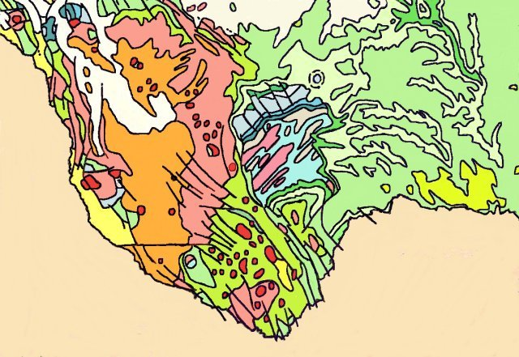

Slide 48
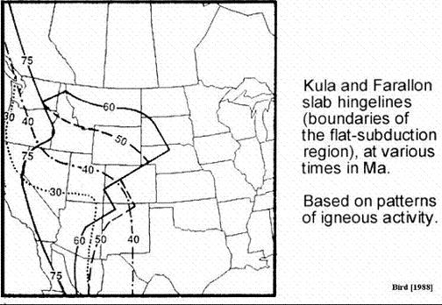

Slide 49
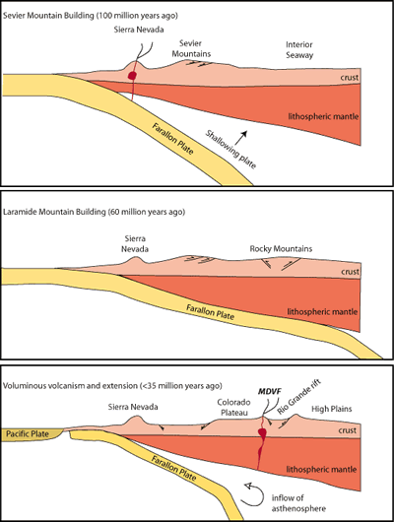

Slide 50
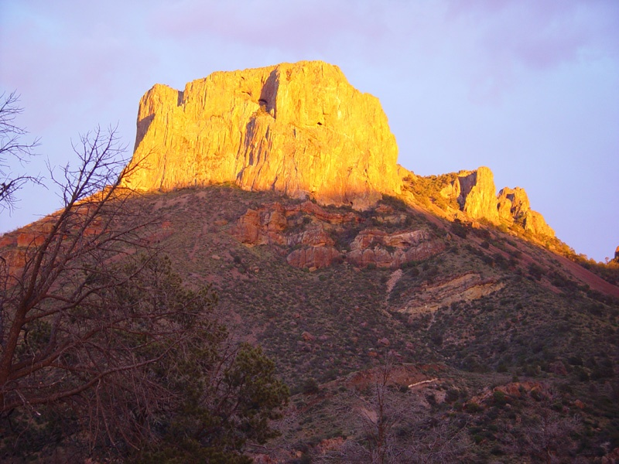
Notes:
Casa Grande

Slide 51
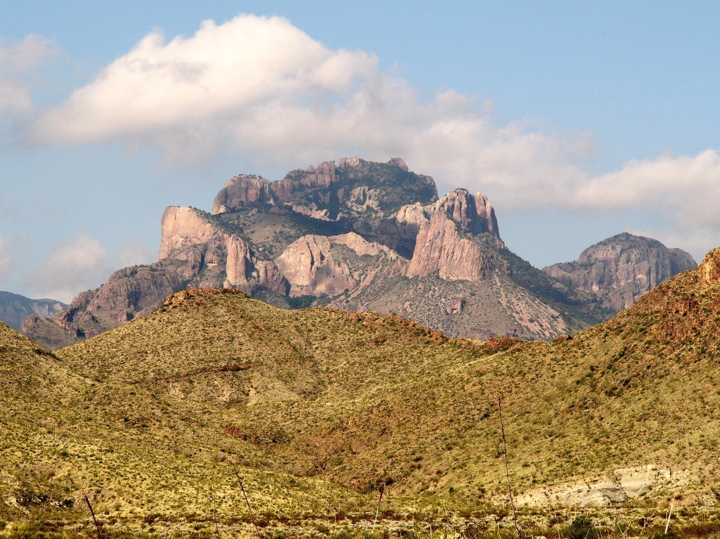
Chisos Mountains (Crown Mountain)
Notes:
This photograph is one of my favorites from Big Bend Vistas 2nd Edition. Crown Mountain is an extinct volcano overlying a volcanic vent on the rim of the Pine Canyon Caldera.
The vent produced ash-flow tuff of the Pine Canyon Rhyolite followed by Boot Rock surge deposits, ash-flow tuffs and lavas and finally a lava dome. The dome is at the west end of the mountain and is not seen in this photograph in which spectacular Boot Rock pinnacles dominate the view. Light gray Chisos tuffs crop out in the foreground at bottom right.
Photographed from Mile 5 on the Rio Grande Village road.

Slide 52
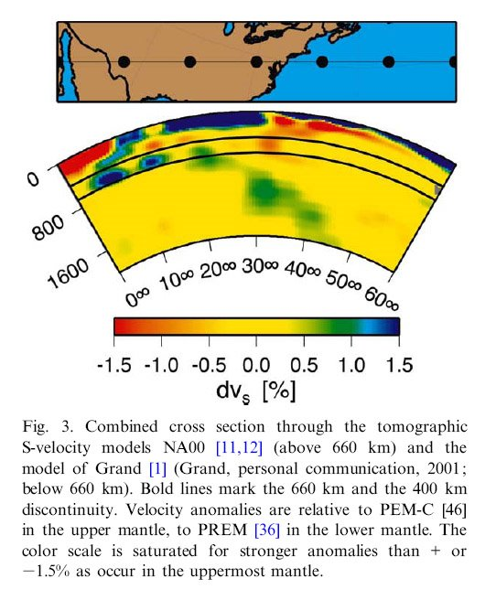

Slide 53
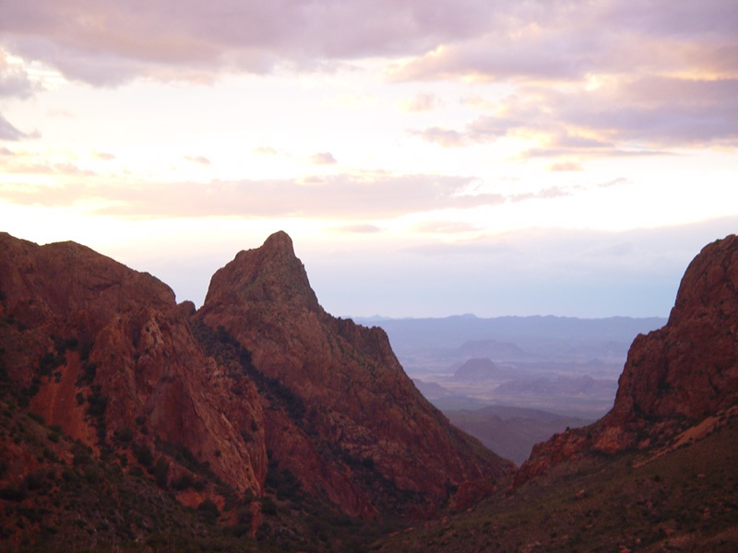
Notes:
Chisos Basin

Slide 54
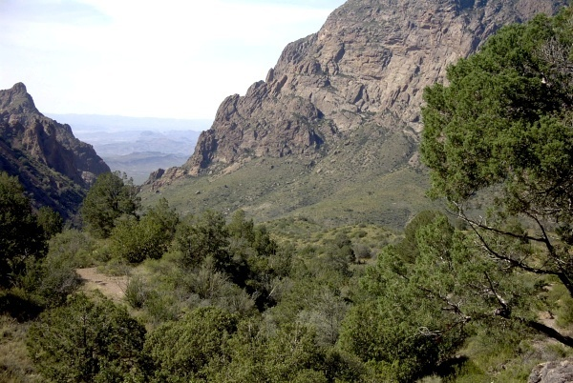
Notes:
All the water that falls on The Basin drains through one canyon, known as The Window because of the spectacular view it provides of the distant lowlands.

Slide 55
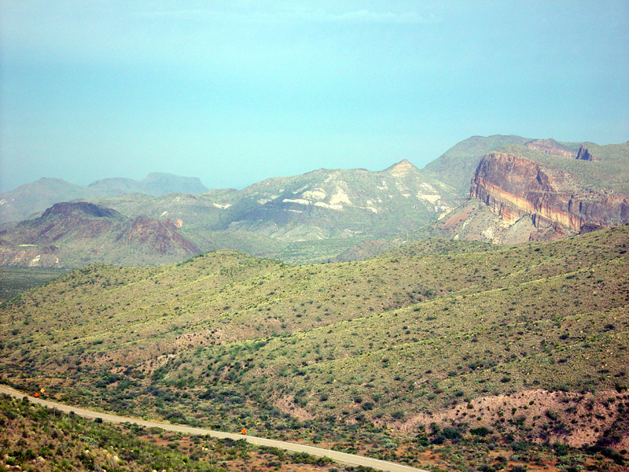

Slide 56
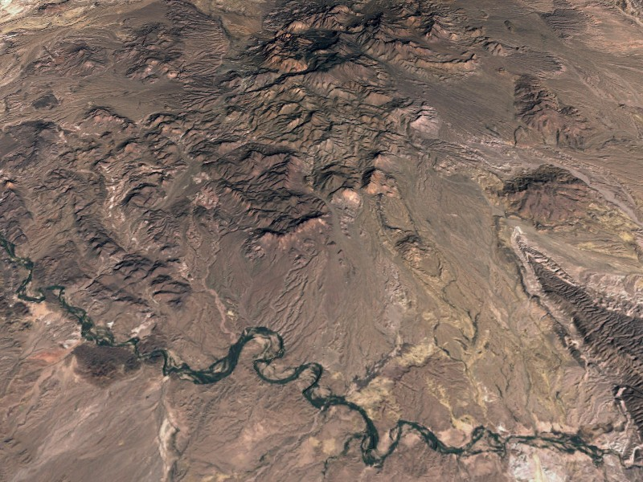
Notes:
Image created in 3DEM by applying a composite Landsat 7 ETM image over merged USGS 7.5' DEMs.

